Slide 1
Protein Synthesis
(digging deeper….)

Slide 2
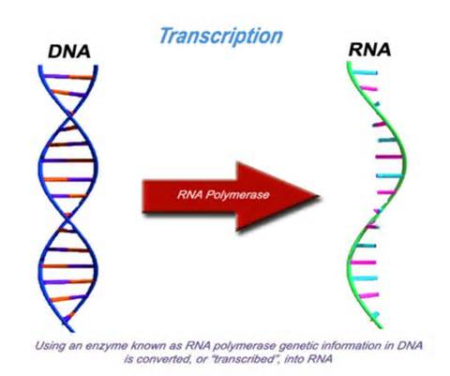
transcription
An enzyme separates the DNA strands and builds an RNA strand- RNA polymerase
ONE strand of DNA is used to makes a strand of mRNA by following base paring rules
Promoters- area of DNA that signals the enzyme where to bind → start area

Slide 3
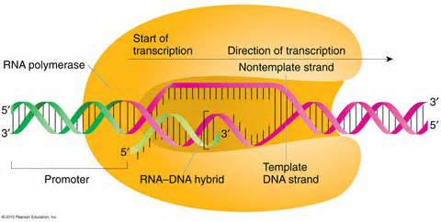
k

Slide 4
INTRONS/EXONS
Some DNA does not code for proteins- introns
Some DNA is coded instructions for proteins- exons
mRNA copies both, so the introns are edited OUT and removed!

Slide 5
Genetic code
The mRNA language is called the genetic code
Bases are read in 3’s= codon
UCG-CAC-GGU
Each codon calls for one of 20 amino acids to form chain of protein

Slide 6
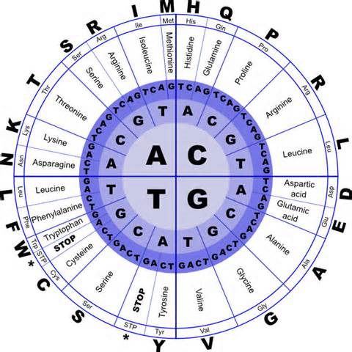

Slide 7
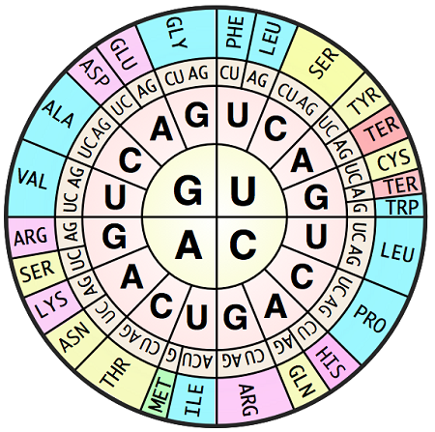
See the difference???? There are charts using the DNA code, and others using the mRNA code. Be careful!

Slide 8
Example……..
mRNA
UCG-CAC-GGU
Serine – Histidine- Glycine

Slide 9
translation
Translation begins when mRNA binds to the ribosome to be read—IN the CYTOPLASM!
As mRNA codons are read, tRNA brings in and drops the amino acid adding to the growing protein chain.
Translation stops when a “stop” codon is reached, everything disassembles, and protein chain breaks free.

Slide 10
Area of tRNA base pairs to mRNA = anticodon
Ex… mRNA = ACG
    tRNA= UGC
Each tRNA can carry only one type of amino acid

Slide 11
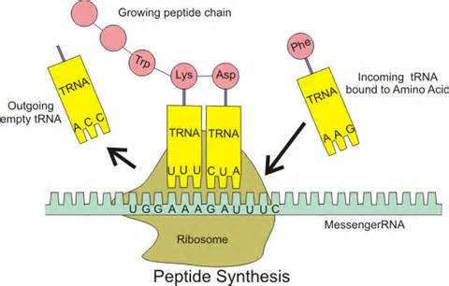
k

Slide 12
You have now studied the roles of DNA and RNA. I used an analogy of a recipe and baking a cake. Use a different analogy to represent the roles of DNA, mRNA, transcription, ribosome, tRNA, amino acids, translation, the finished protein. Create a diagram with a key showing what each part of the diagram represents!

